Slide 1
WomenTechWomenYes (WTWY) Summer Gala 2019
Presenters
Stephen Ilhardt
Maxwell Clarke
Max Barry

Slide 2
Goal
Advise WTWY on the best use of street teams working in advance of the New York City 2019 Summer Gala.
Recommend
Busiest Stations
Best Days
Most effective use of teams
Best days to go to the busiest station

Slide 3
Motivation
More $$$
More women in tech!
More Signatures
More Attendees
Publicity

Slide 4
Tools And Data
Data from the MTA website organized by week
Utilized pandas library for cleaning, organization, and manipulation
Matplotlib and seaborn used for exploration and visualization

Slide 5
Data Cleaning
Analyzed MTA data from most recent year (2018) in May
Created weekday variable from date variable
Filtered out unrealistic data points

Slide 6
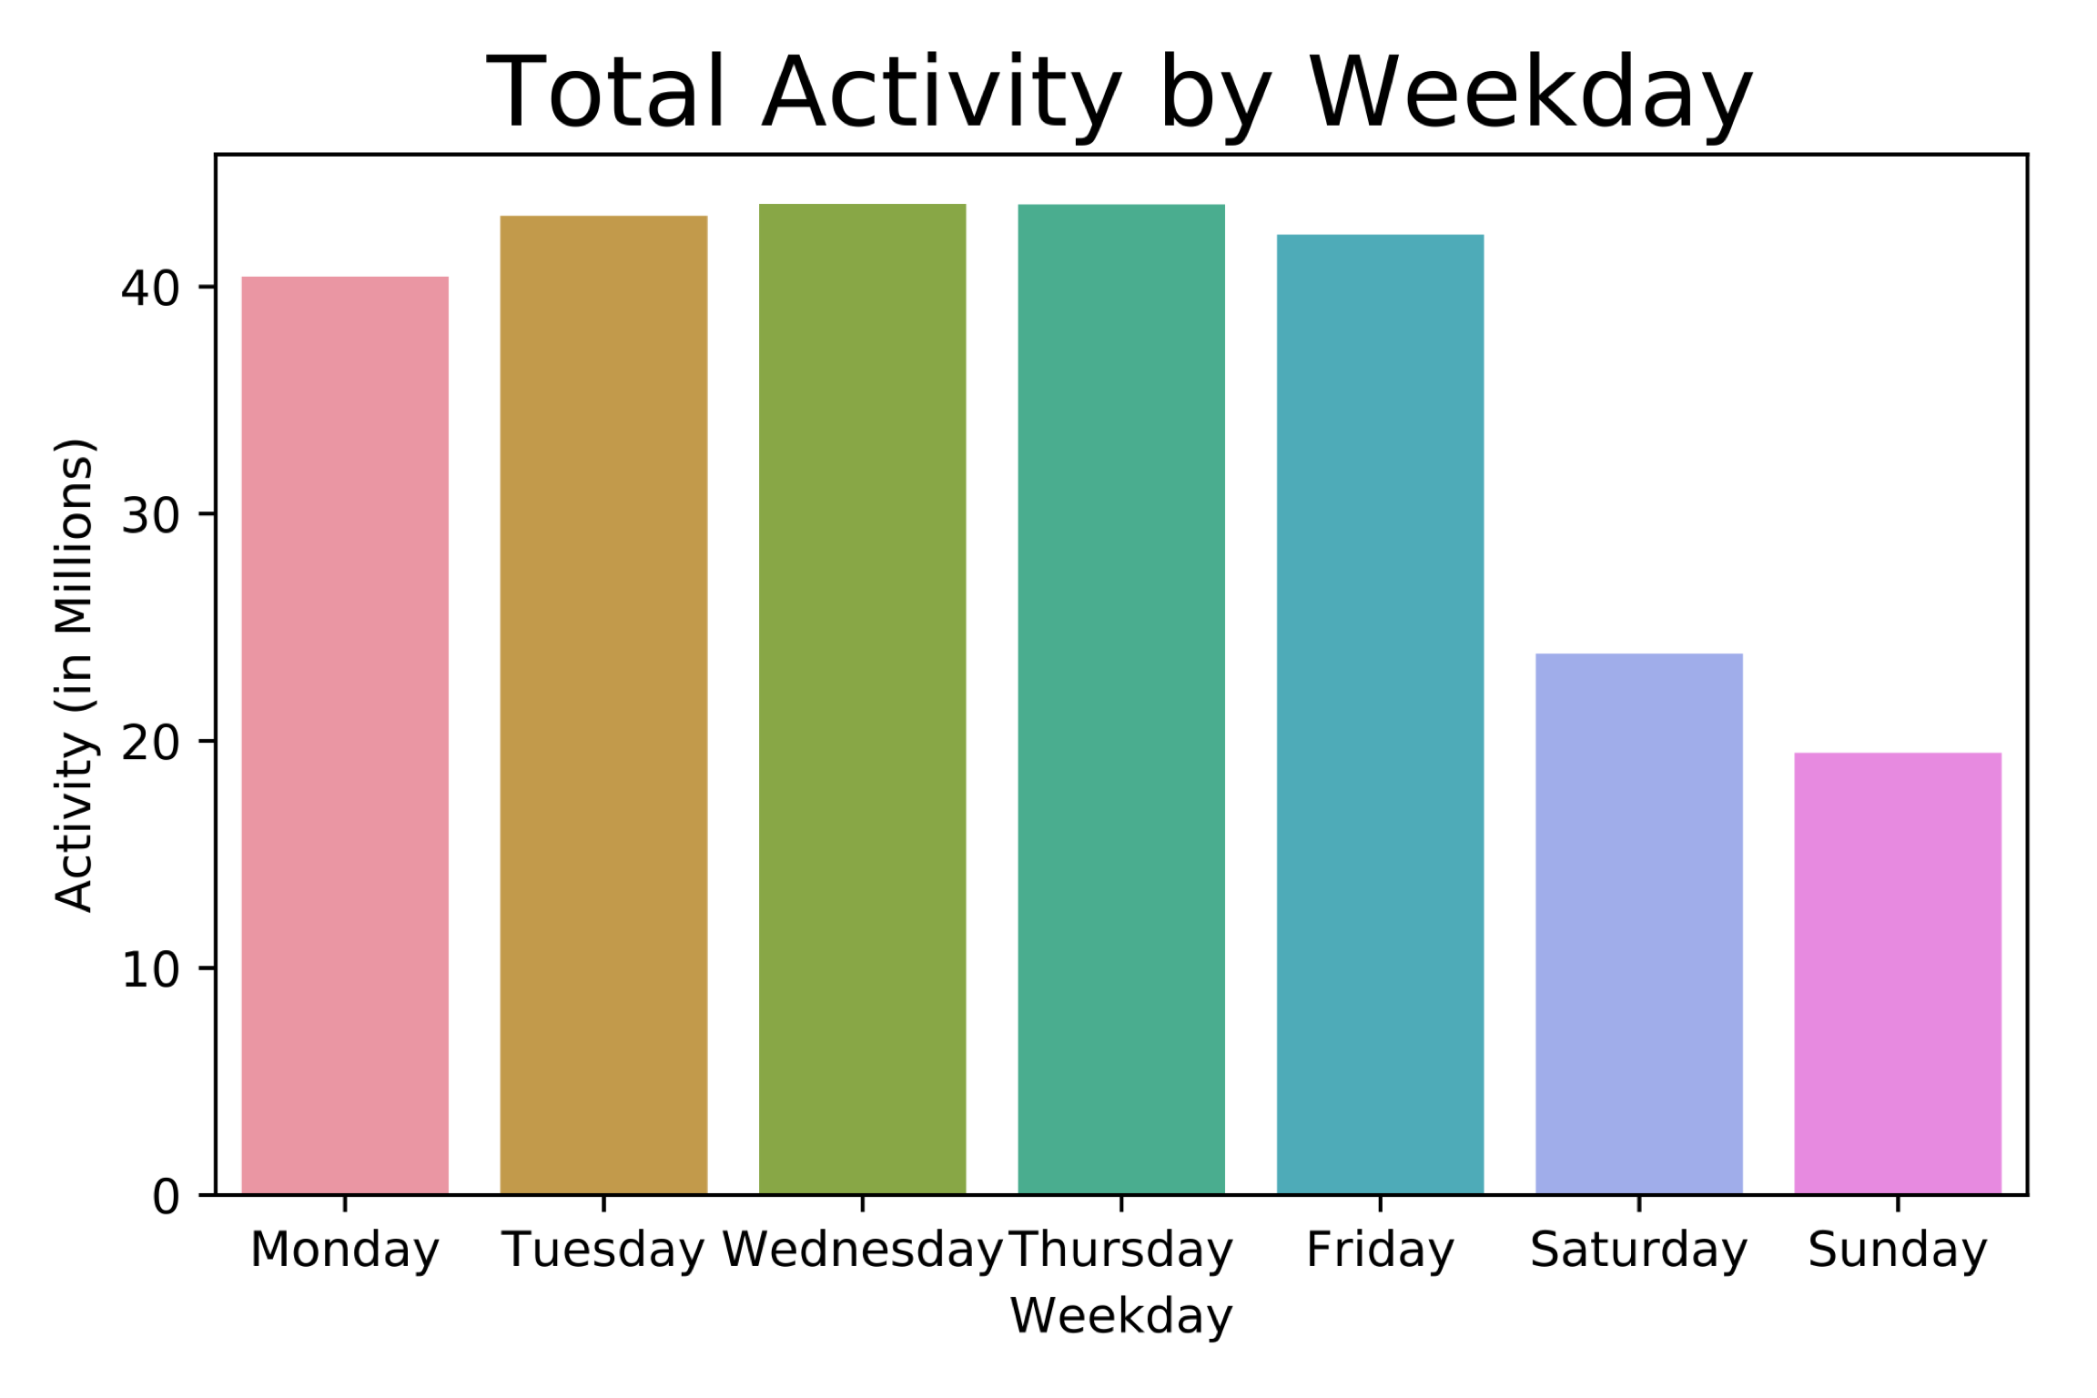
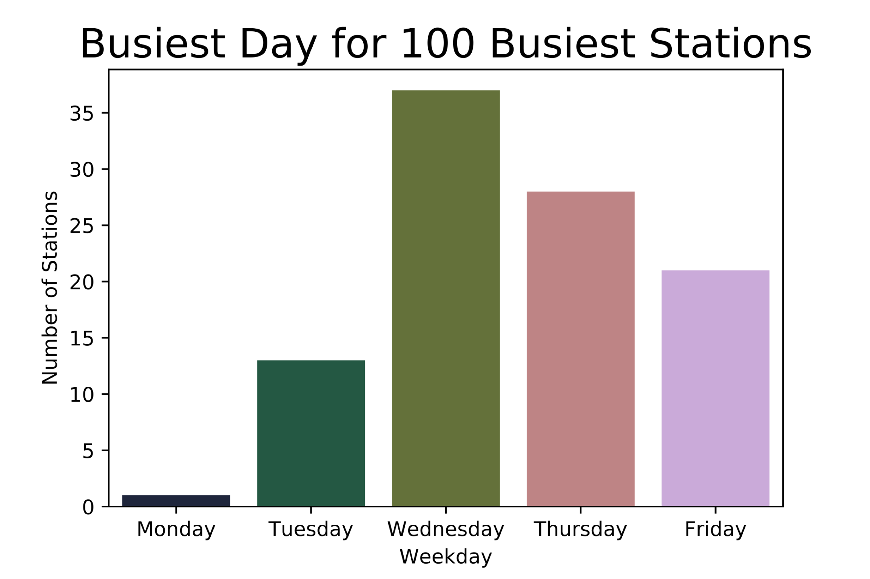
By Day Of Week
Weekday exceeds weekend activity
Activity peaks mid-week
Wednesday & Thursday are busiest

Slide 7
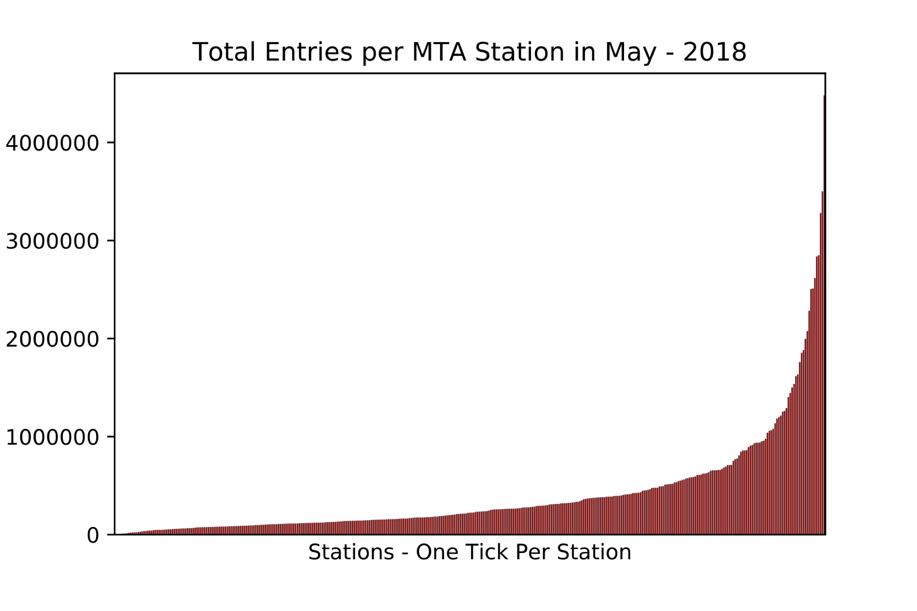
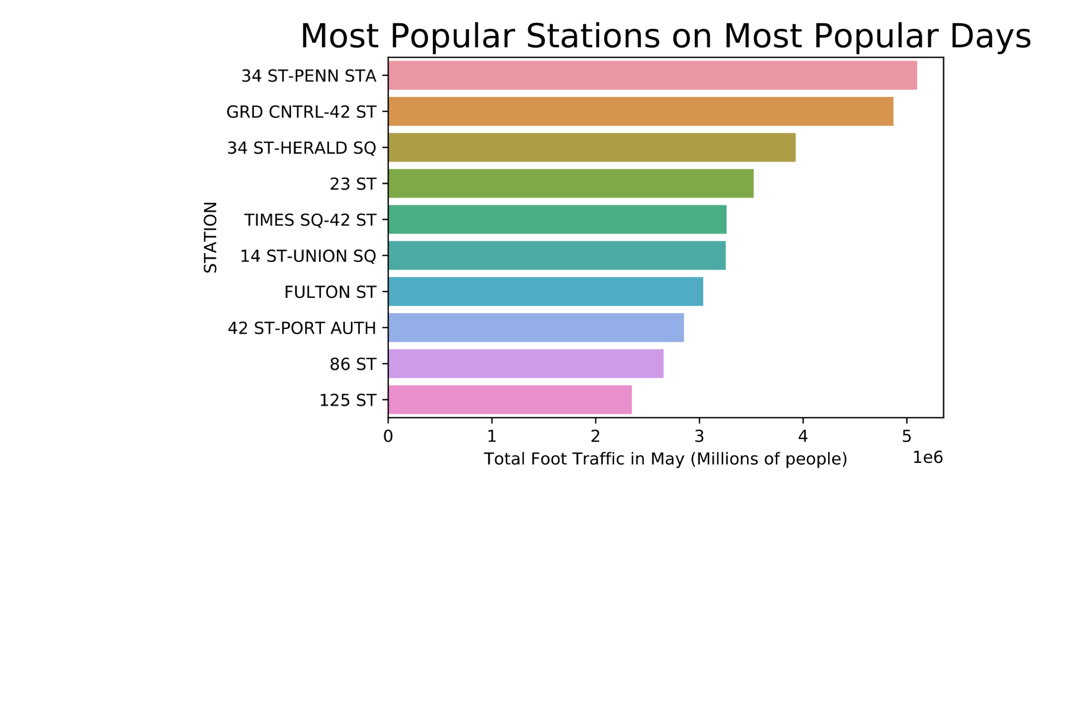
By Station
Large gap between activity for busiest stations and typical station
Top 1% of stations have 44% of all traffic on most popular days

Slide 8
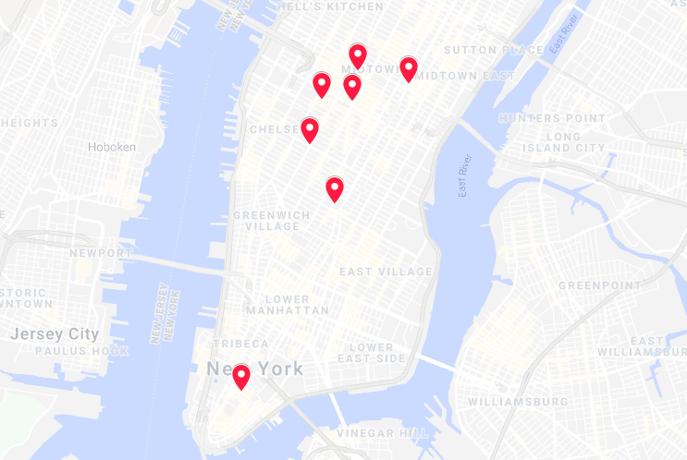
Recommendations
Target Tuesday through Friday
Penn Station
Grand Central
Herald Square
23rd Street
Times Square
Union Square
Fulton Street

Slide 9
Further Work
Extend date range
Target Demographics
Disperse Across Neighborhoods
Age - Gender – Income

Slide 10
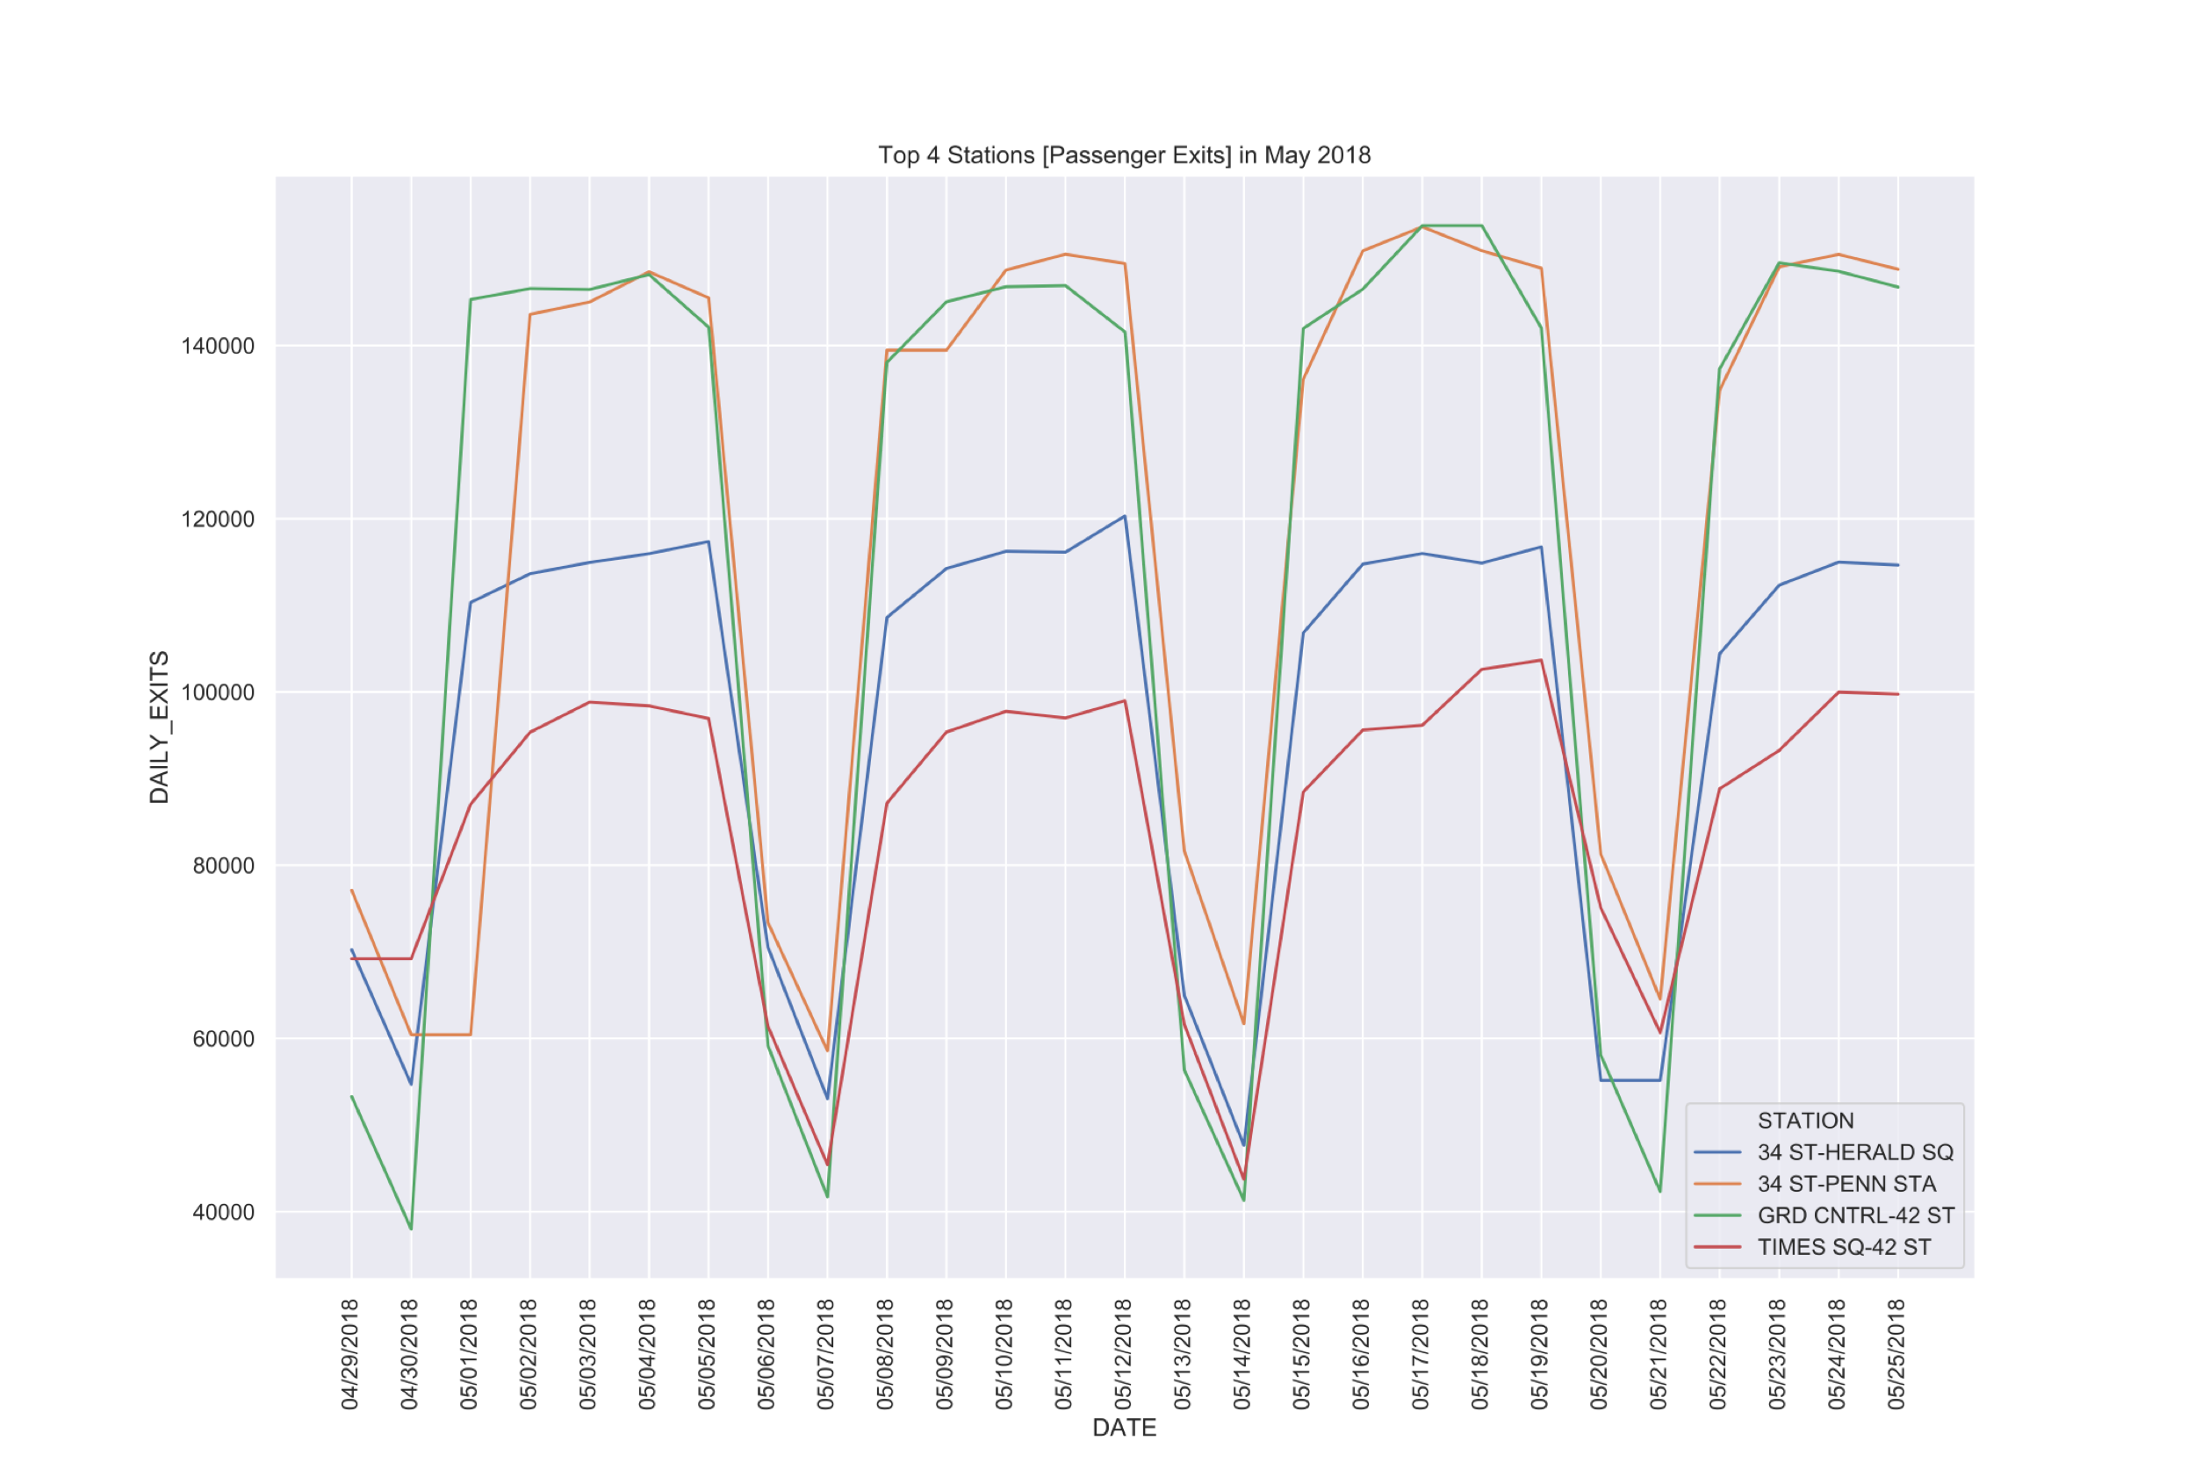
Appendix

Slide 11
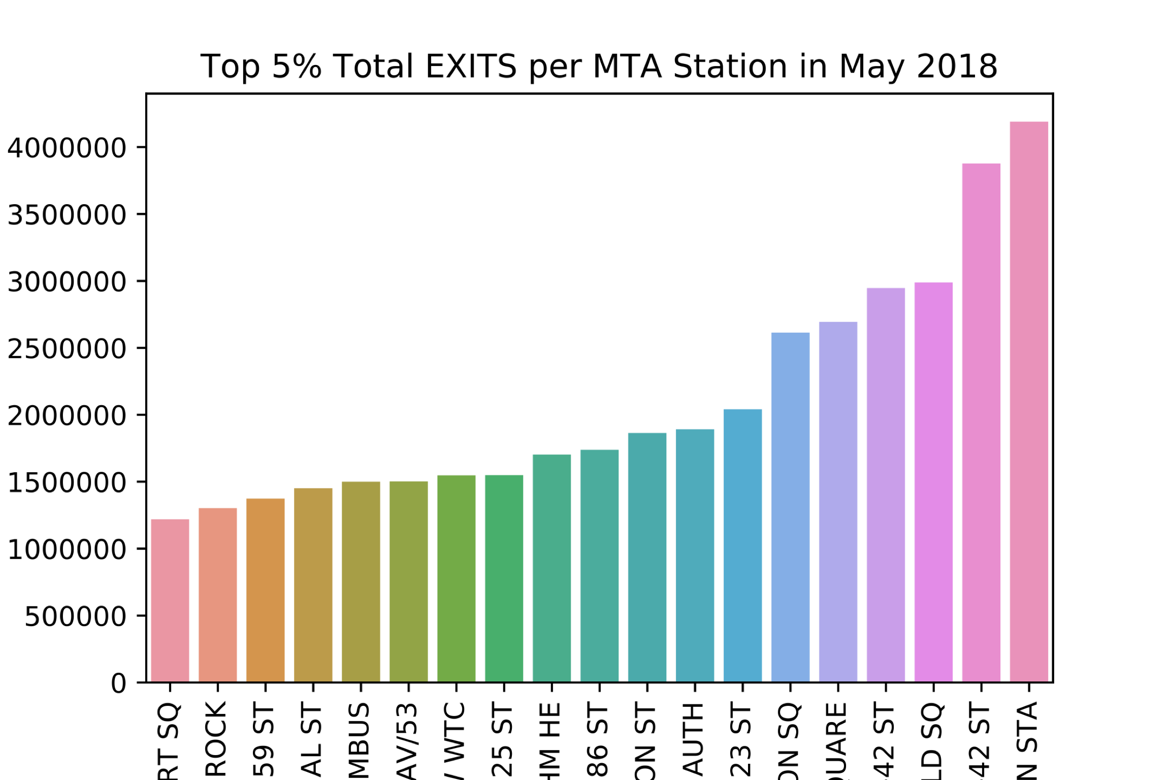
Appendix

Slide 12
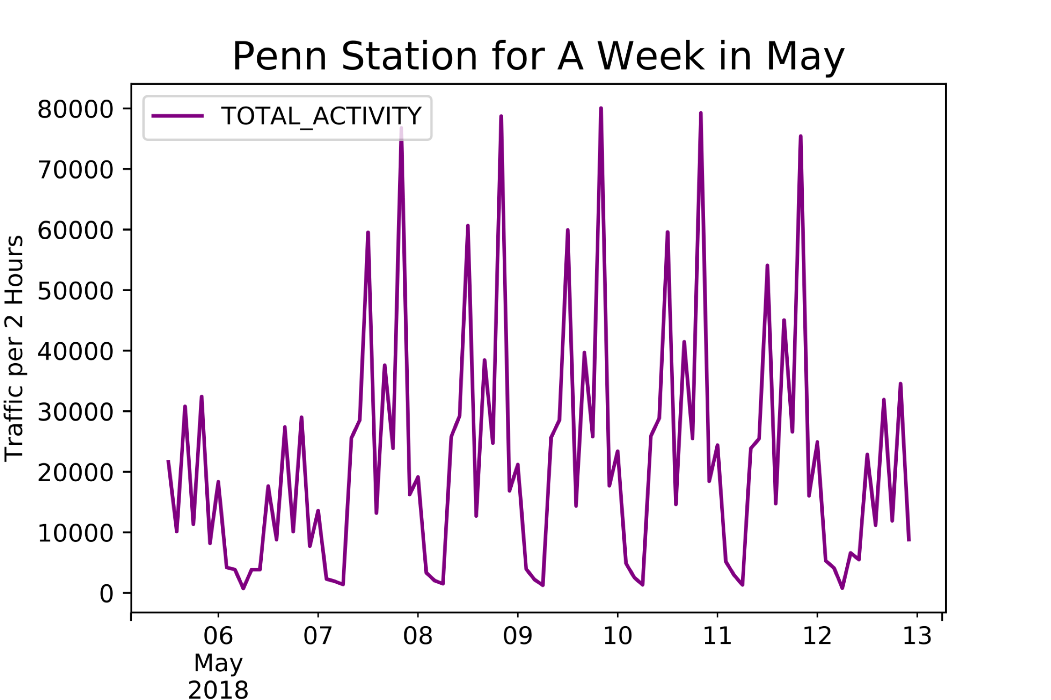
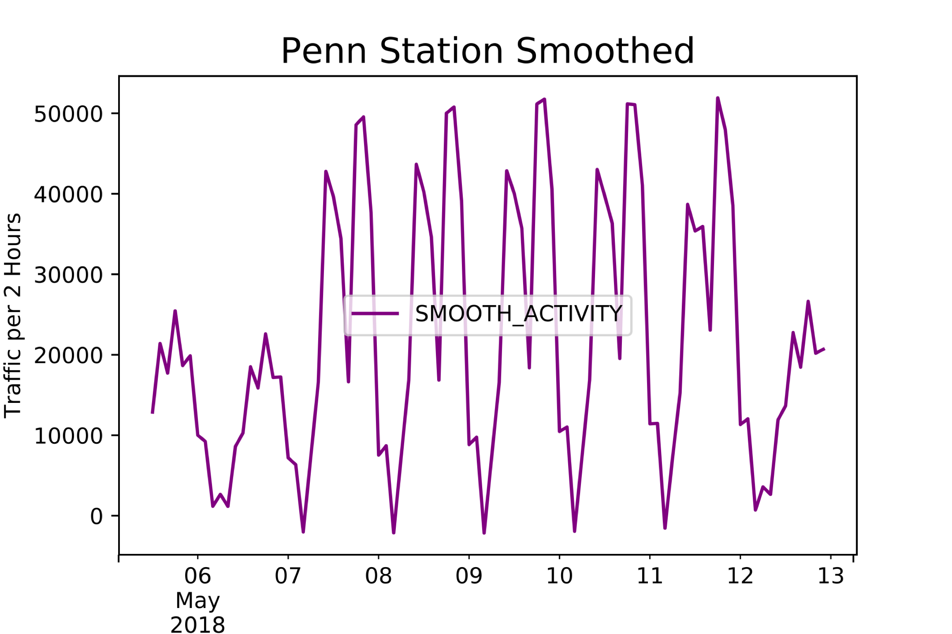
Appendix
Savitzky-Golay Filter can be used to smooth noisy data to
better visualize foot traffic

